Slide 1
Neural Net Report
Your Name: Lucas Luwa
Your GT Username: lluwa3

Slide 2
Question 5: Learning With Restarts
testPenData:
Max accuracy: 0.9102344196683819
Average accuracy: 0.8999428244711263
Standard deviation: 0.008338615247097609
testCarData:
Max accuracy: 0.995
Average accuracy: 0.985
Standard deviation: 0.008944271909999166

Slide 3
Question 6: Varying the Hidden Layers
Statistic table for testPenData – report the max, average, and standard deviation at various amount of perceptrons.
 | Number of Perceptrons at the Hidden Layer
 | 0 | 5 | 10 | 15 | 20 | 25 | 30 | 35 | 40
Max Accuracy | 0.0 | 0.8525 | 0.8991 | 0.9097 | 0.9091 | 0.9097 | 0.9054 | 0.9045 | 0.9039
Avg Accuracy | 0.0 | 0.8440 | 0.8915 | 0.9017 | 0.9071 | 0.9058 | 0.9002 | 0.9034 | 0.9003
Standard Deviation | 0.0 | 0.0065 | 0.0060 | 0.0065 | 0.0013 | 0.0027 | 0.0074 | 0.0008 | 0.0022

Slide 4
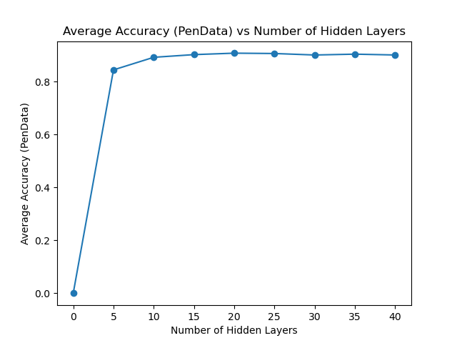
Question 6: Varying the Hidden Layers
Create a learning curve for testPenData where the number of hidden layer perceptrons is the independent variable and the average accuracy is the dependent variable.
[attach your image/graph here]

Slide 5
Question 6: Varying the Hidden Layers
For testPenData, discuss any notable trends you saw related to increasing the size of the hidden layers in your neural net.
Answer:

Slide 6
Question 6: Varying the Hidden Layers
Statistic table for testCarData – report the max, average, and standard deviation at various amount of perceptrons.
 | Number of Perceptrons at the Hidden Layer
 | 0 | 5 | 10 | 15 | 20 | 25 | 30 | 35 | 40
Max Accuracy | 0.71 | 0.97 | 0.99 | 0.99 | 0.98 | 0.985 | 0.99 | 0.99 | 0.99
Avg Accuracy | 0.71 | 0.967 | 0.985 | 0.985 | 0.976 | 0.978 | 0.987 | 0.98 | 0.974
Standard Deviation | 0.0 | 0.0024 | 0.0032 | 0.0077 | 0.0037 | 0.0051 | 0.0024 | 0.0071 | 0.0097

Slide 7
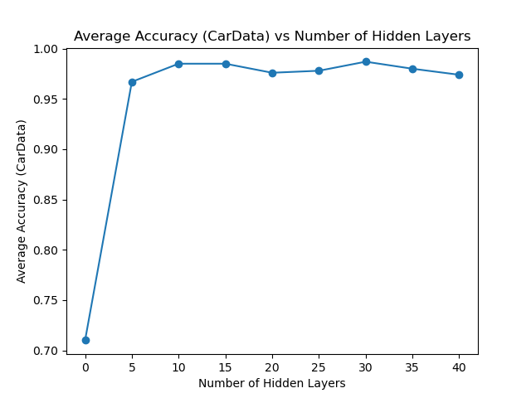
Question 6: Varying the Hidden Layers
Create a learning curve for testCarData where the number of hidden layer perceptrons is the independent variable and the average accuracy is the dependent variable.
[attach your image/graph here]

Slide 8
Question 6: Varying the Hidden Layers
For testCarData, discuss any notable trends you saw related to increasing the size of the hidden layers in your neural net.
Answer:

Slide 9
Question 7 (extra credit): Learning XOR
Report the max accuracy, average accuracy, and standard deviation of the neural net that you have trained with 1) no hidden layer, and 2) a hidden layer with various amount of perceptrons (at least 3 different amounts)
 | No Hidden Layer | Hidden Layer
 |  | ___ perceptrons | ___ perceptrons | ___ perceptrons
Max Accuracy
Avg Accuracy
Standard Deviation

Slide 10
Question 7 (extra credit): Learning XOR
Report the behavior of the trained neural net without a hidden layer.
Answer:

Slide 11
Question 7 (extra credit): Learning XOR
Report the behavior of the trained neural net with a hidden layer. Are the results what you expected? Explain your observation.
Answer:

Slide 12
Question 8 (extra credit): Novel Dataset
List the name and the source of the dataset that you’ve chosen.
Name: ______
Source (e.g., URLs): ______
Briefly describe the dataset: _____

Slide 13
Question 8 (extra credit): Run Stats
Max accuracy: _______
Average accuracy: _______
Standard deviation: ________

Slide 14
Question 8 (extra credit): Novel Dataset
Describe how to run the code that you’ve set up to train the selected dataset.
Answer:

